Slide 1

Data communications and networking Project: Motion Sensor security camera system
Created by Stephanie Prem
Notes:
Hello, I am Stephanie Prem. For my project I created a motion sensor security camera system.

Slide 2
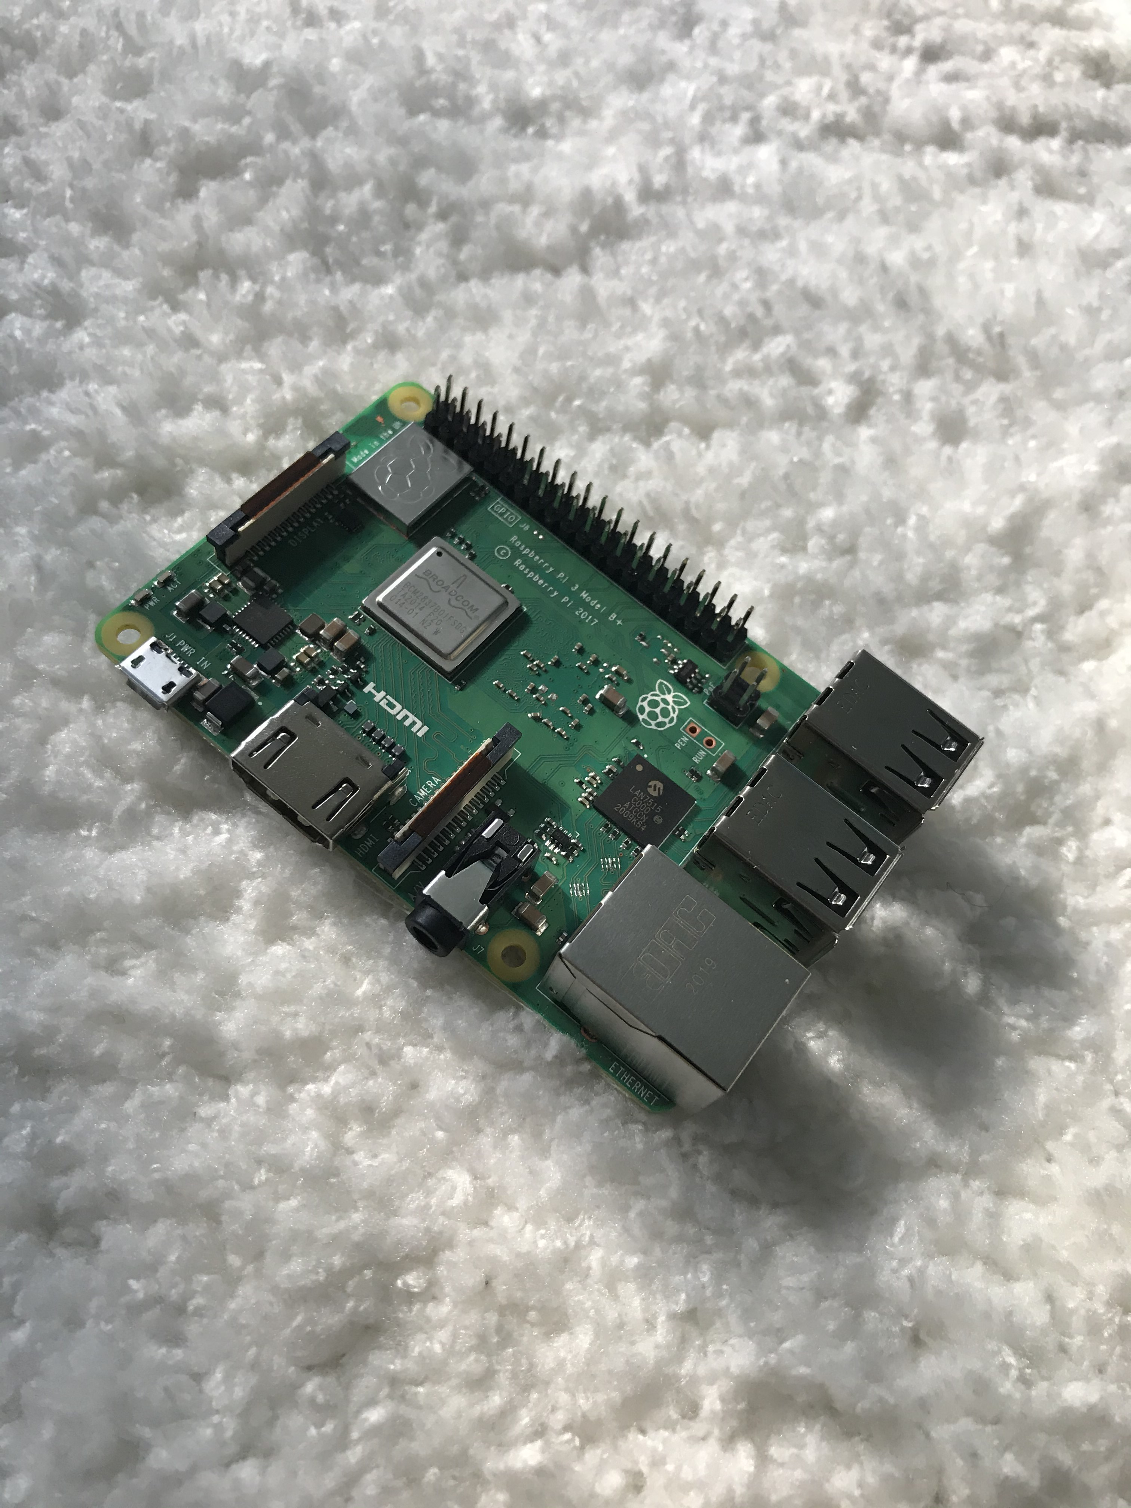
The hardware needed…
2 Raspberry Pi
2 Power Sources
2 Cases
2 Micro Chips
A Chip Converter
2 Raspberry Pi Cameras
A monitor is also needed…
Notes:
To complete this project I used 2 raspberry pis, 2 power source, 2 cases, 2 micro chips, a chip converter that connects to my laptop, 2 raspberry pi cameras, and a monitor to connect to the raspberry pi to find the IP address.

Slide 3
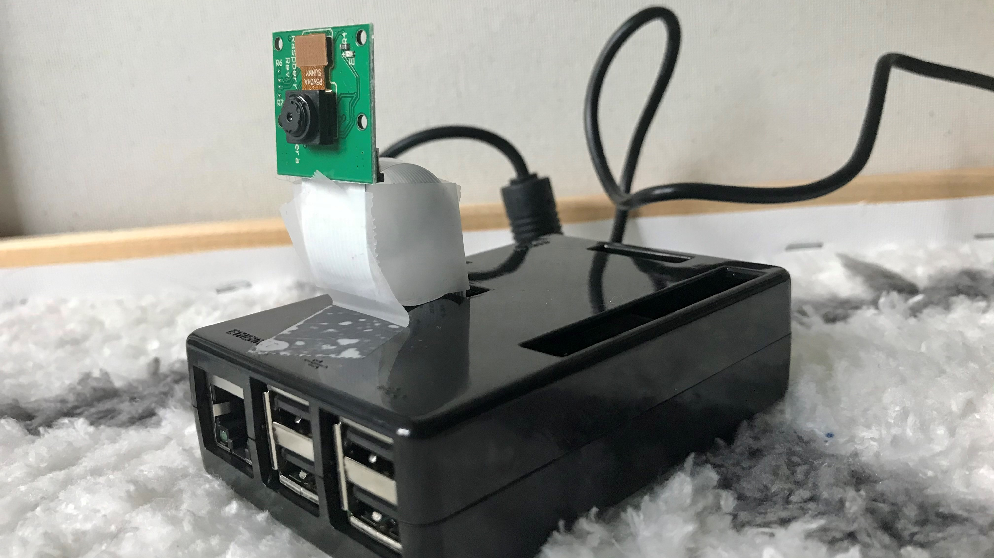
FINISHED PRODUCT
Notes:
This is the finished product of one camera. The camera was tapped into place to give it more support.

Slide 4
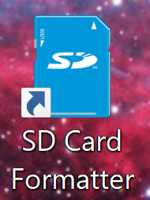
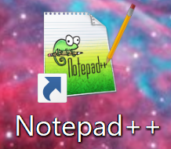
STEP 1
Download:
Notes:
The two applications that were needed were SD Card formatter and notepad ++. The SD card formatter was used format each chip to hold the program and notepad++ was used to put the code needed to connect to my networks wifi.

Slide 5

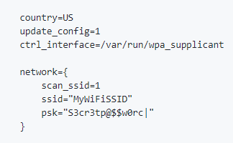
CODE NEEDED
https://github.com/ccrisan/motioneyeos/releases
Notes:
I got the code for motioneyeos from github. The code I downloaded was created for a raspberry pi3 which matches the ones I used. On the right is the code used to connect to my networks wifi. Don’t worry this is sample information and not my actual wifi network information shown.

Slide 6

STEP 2
Format the Micro Chip and download the code onto the chip and connect it to the WIFI
Put the chip into the Raspberry Pi
Find the IP Address
Notes:
For each micro chip I formatted them with the SD card formatter, downloaded the motioneyeos code, and the wifi code. Then I inserted each micro chip into different raspberry pis. Finally, I connected the raspberry pis one at a time to the monitor. When I did this the motioneyeos application ran and provided the ip address of the raspberry pi.

Slide 7
MotionEye OS
How this program was used:
Search the IP Address to open MotionEyeOS
From here add the second camera
Notes:
The next step I took was searching one of the raspberry pis IP address in a web browser. This showed the motioneyeos application running and showed the schematics of the camera and what the camera was viewing. I was able to connect the second camera from this first camera window completing the security system.

Slide 8
CITATIONS
Dick, B. (2019, September 24). Step by Step guide to convert Raspberry Pi 3 to Motion Detection Security Camera. Retrieved October 1, 2020, from https://www.youtube.com/watch?v=_wnOPUOv2_I&feature=emb_logo
Gus. (2020, July 06). Build a Raspberry Pi Security Camera Network. Retrieved October 1, 2020, from https://pimylifeup.com/raspberry-pi-security-camera/comment-page-7/
PcMac. (2018, April 20). MotionEyeOS Motion Triggered E-mail Notifications. Retrieved October 1, 2020, from https://www.youtube.com/watch?v=OAVvWFT1v5I
PcMac. (2019, April 21). MotionEyeOS Complete Setup. Retrieved October 21, 2020, from https://www.youtube.com/watch?v=luI391iadIU&feature=emb_logo
Scavix, & Instructables. (2017, October 19). Raspberry Pi As Low-cost HD Surveillance Camera. Retrieved October 1, 2020, from https://www.instructables.com/Raspberry-Pi-as-low-cost-HD-surveillance-camera/

Slide 9
DEMO!

